Slide 1
Authentication in Azure Functions
Joel Rodrigues

Slide 2

Joel Rodrigues
SharePoint Developer at Storm Technology Ltd
Microsoft MVP - Office Development
10+ years developing SharePoint solutions
@JoelFMRodrigues
https://www.m365-dev.com
LET ME INTRODUCE MYSELF…

Slide 3
Typical scenarios to consider
Azure Function to connect to SharePoint using app-only permissions
Trigger Function via queue items
Trigger Function via HTTP request
From Logic Apps or PowerAutomate
From .NET (MSAL)
From the browser as an end-user via SPFx
From other Function

Slide 4

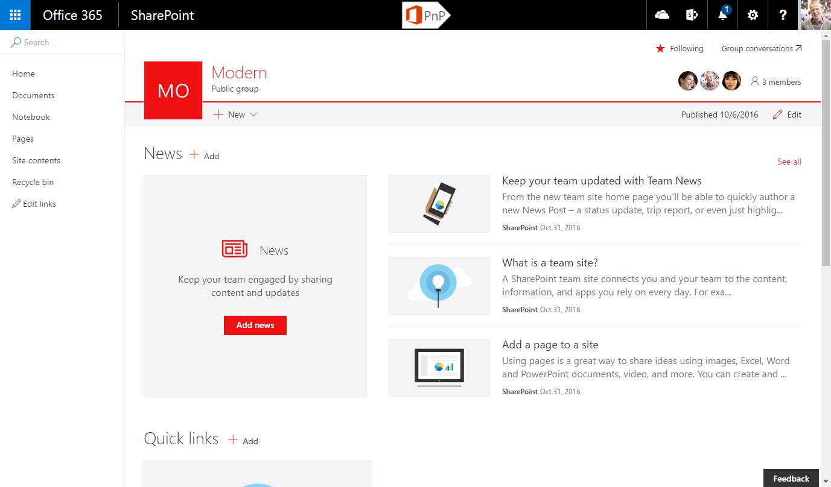
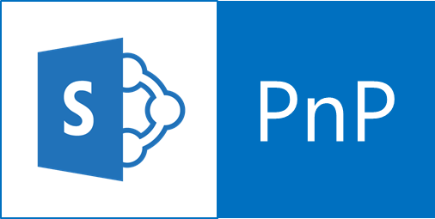
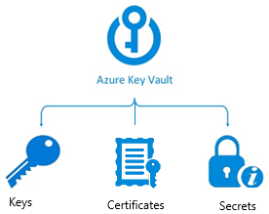
Connect to SharePoint using Azure AD app and certificate
Function execution started
Function code requests app Id and Certificate from Function app settings. Function uses Key Vault references to request the values using managed identity
Key Vault ensures Function has access permissions to execute the request and returns values
Function uses App Id and Certificate to connect to SharePoint
Azure Function
1
4
2
3
Connect-PnPOnline -Url $SiteUrl -ClientId $AuthId
-Tenant "$SPOTenant.onmicrosoft.com"
-CertificateBase64Encoded $Certificate

Slide 5
Demo
Azure AD application
API permissions
Certificate
Key Vault
Secrets
Certificates
Access Policies
Azure Function
Managed Identity
App settings
Authentication

Slide 6
But when you create a new Function…
What security is already in place?
How is access controlled?
Who can access the Function?

Slide 7
Everyone can get in…

Slide 8
Connect to Function from SPFx
const options: IHttpClientOptions = {
headers: {
"Content-Type": "application/json;odata=verbose",
Accept: "application/json;odata=verbose",
},
mode: "cors",
body: JSON.stringify({
APIData: data
})
};
const client: AadHttpClient = await this.wpContext.aadHttpClientFactory.getClient(apiUrl);
const response: HttpClientResponse = await client.post(apiUrl, AadHttpClient.configurations.v1, options);
const result: any[] = await response.json();

Slide 9
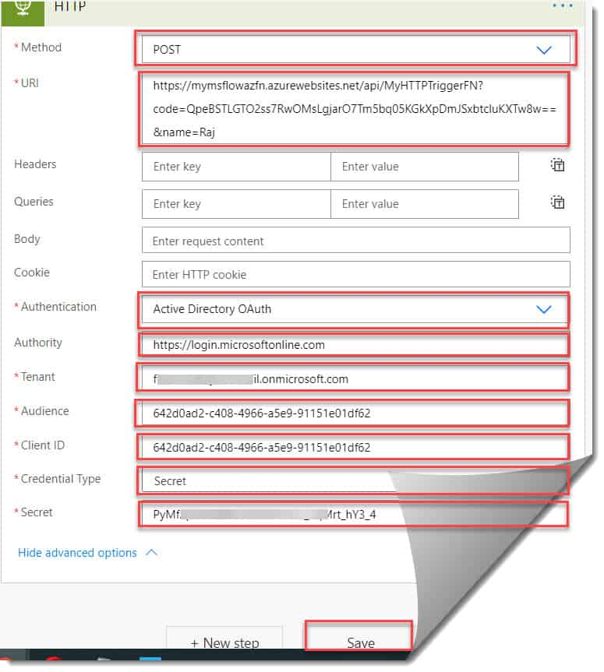
Connect from Logic App or PowerAutomate

Slide 10
Using a Function template solution to
Automate the entire setup process
Functions always fully configured from the start
Ready to use
Time saving
Less mistakes

Slide 11
Resources
Granting access via Azure AD App-Only | Microsoft Docs
Calling An Azure Function From Power Automate (MS Flow) - Azure Lessons
Learn about MSAL - Microsoft identity platform | Microsoft Docs
AzureAD/MSAL.PS (github.com)
Calling Azure Function from PowerShell - Simon Wahlin
Connect to API secured with Azure Active Directory (Azure AD) | Microsoft Docs
Use Key Vault references - Azure App Service | Microsoft Docs

Slide 12
Demo Function Code
$siteUrl = "https://contoso.sharepoint.com/sites/demosite"
$AuthId = $env:AuthId
$SPOTenant = “contoso.onmicrosoft.com"
$Certificate = $env:Certificate
Connect-PnPOnline -Url $SiteUrl -ClientId $AuthId -Tenant $SPOTenant -CertificateBase64Encoded $Certificate
Write-Information "Connected to site"
Get-PnPList
Write-Information "Done!"

